Slide 1
Object Detection and Localization.
Hina Ali

Slide 2
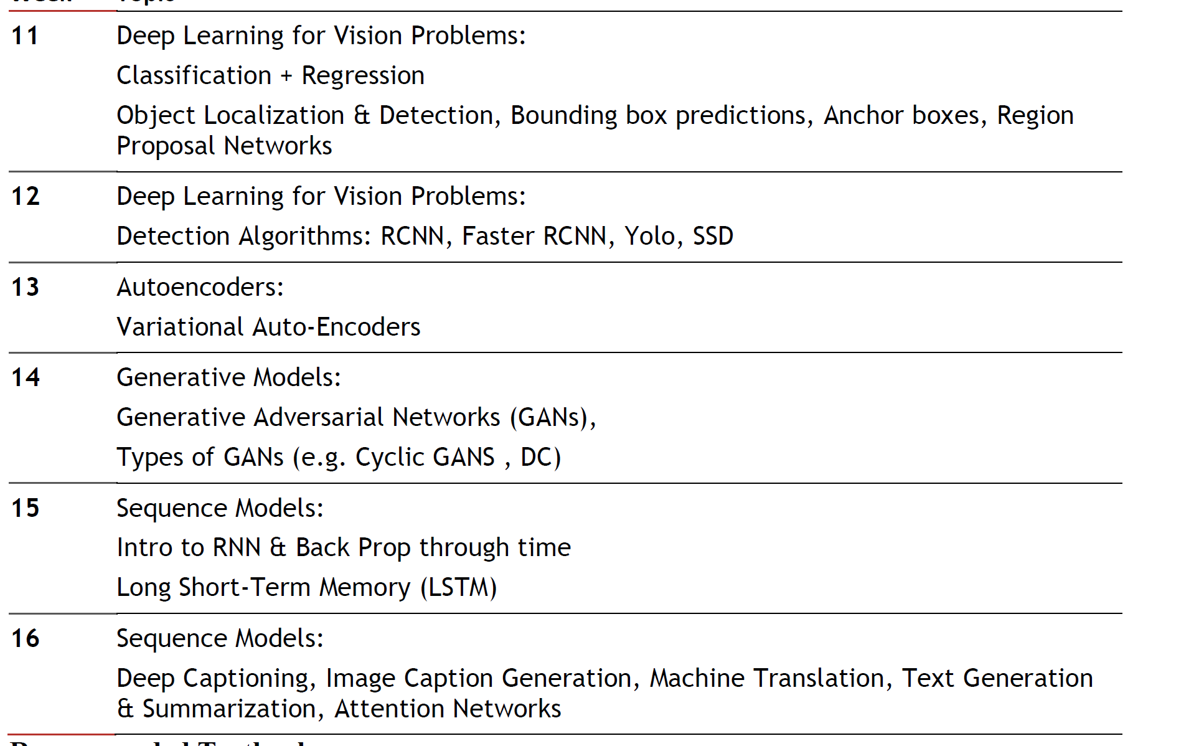
Course left

Slide 3
Let's start from top-down approach
Start reading Papers
Start with most cited paper then most recent one,
Highlight important point and add comments with highlighted points.
Highlight concept that you don’t understand with different color
Search that topic on internet chatgpt .
Copy the explanation into comment box of highlighted text for future reference

Slide 4
Localization and Object detection
Localization and Object detection are two of the core tasks in Computer Vision
the most used terms and their meaning :
Classification/Recognition: Given an image with an object, find out what that object is. In other words, classify it in a class from a set of predefined categories.
Localization: Find where the object is and draw a bounding box around it
Object detection: Classify and detect all objects in the image. Assign a class to each object and draw a bounding box around it.
Semantic Segmentation: Classify every pixel in the image to a class according to its context, so that each pixel is assigned to an object
Instance Segmentation: Classify every pixel in the image to a class so that each pixel is assigned to a different instance of an object

Slide 5
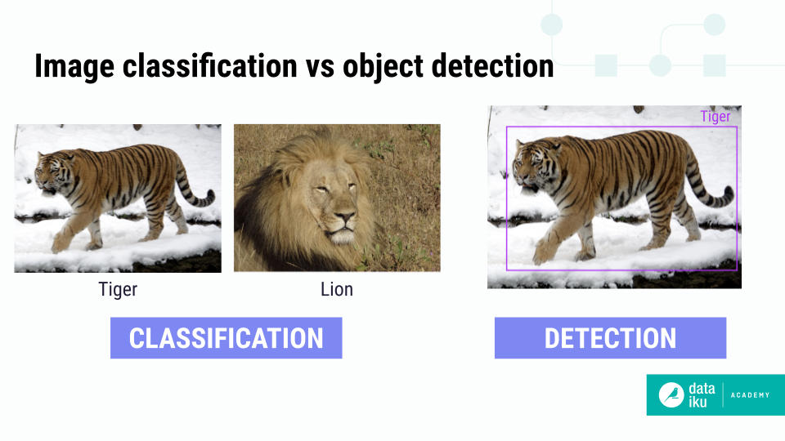
Image Classification Versus Object Detection
source

Slide 6
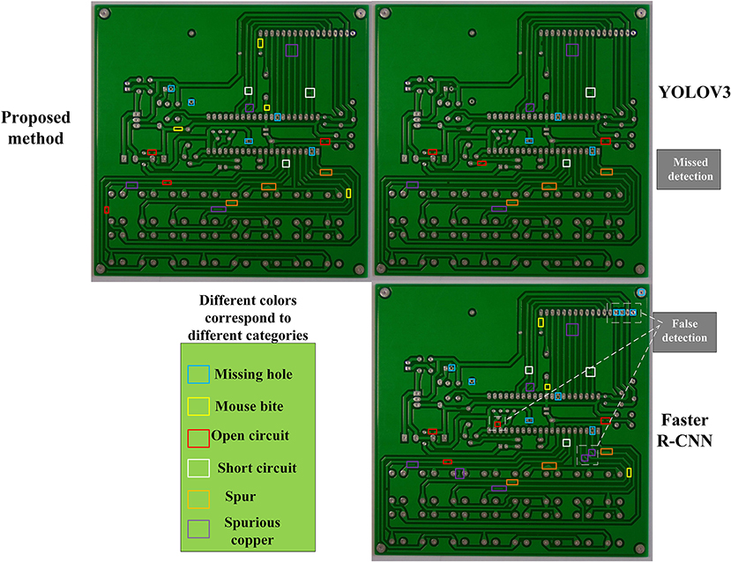
To check circuit boards and classify them as either defect or correct. While it is essentially a classification problem, the defects might be too small to be noticeable with an image classification model.so object detection can be used for classification.
object detection, provides a more fine-grained, granular, regional level of the image.
In classification one might lose track of the classification signal

Slide 7
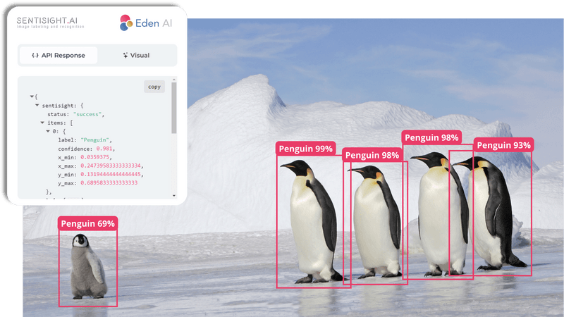
Data requirements
To train a custom model, labelled data is required. Labelled data in the context of object detection are images with corresponding bounding box coordinates and labels. That is, the bottom left and top right (x,y) coordinates and the class
Source

Slide 8
Main Questions
In order to do object detection on problem X, how many images I need.
Important thing to consider is scenario of deployment.
Initially a large number (for example, > 100 and potentially >1000) representative images are available per class.
Example: A traffic sign detection model that runs in a car, require images taken under different weather, lighting and camera conditions in their appropriate context.
If the model does not have enough data to learn general patterns, it won’t perform well in production.

Slide 9
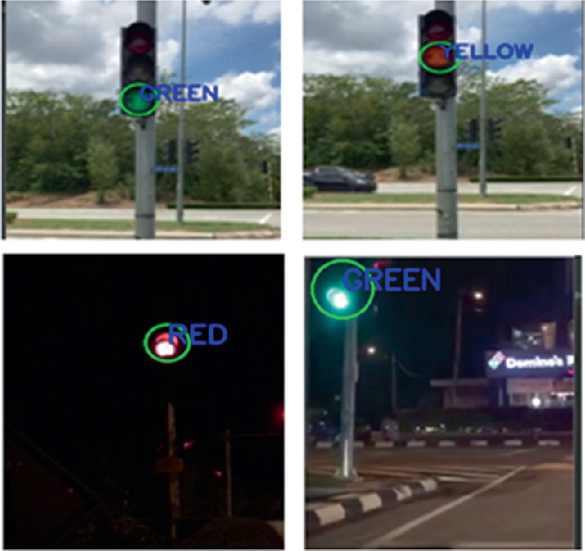
source

Slide 10
General Object Detection Framework
Typically, there are three steps in an object detection framework.
Generate Region Proposals: The first step is to create many potential bounding boxes in the image where objects might be. These are called region proposals, and they cover the whole image to suggest where objects could be located.
Classify Objects in Proposals: After the region proposals are generated, the next step is to look at each box and figure out what object (if any) is inside. This is done by extracting visual features from each box and checking whether it's an object, and if so, which one.
Remove Overlapping Boxes: The final step is to clean up the results. Often, multiple boxes may detect the same object, so overlapping boxes are combined into one. This process is called non-maximum suppression, which keeps only the best bounding box for each object.
In simple terms, it's like guessing where objects are in an image, identifying what they are, and then cleaning up duplicate guesses.

Slide 11
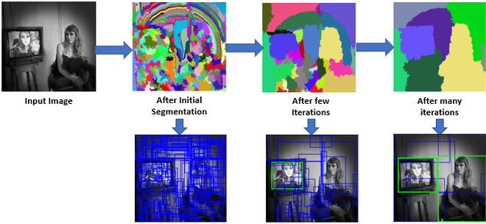
Region Proposals
Several different approaches exist to generate region proposals. Originally, the ‘selective search’ algorithm was used to generate object proposals. An example of selective search applied to an image. A threshold can be tuned in the SS algorithm to generate more or fewer proposals.
source

Slide 12
Further in other approaches:
More complex visual features extracted from the image to generate regions like deep learning or brute force for region generation
In brute force sliding window is used, Each of the bounding boxes will be used as a region of interest (ROI).
An important trade-off that is made with region proposal generation is the number of regions vs. the computational complexity.

Slide 13
Feature Extraction
The goal of feature extraction is to reduce a variable sized image to a fixed set of visual features.
Non-maximum suppression
The general idea of non-maximum suppression is to reduce the number of detections in a frame to the actual number of objects present
is a technique commonly used in object detection to eliminate redundant or overlapping bounding boxes, ensuring that each object in an image is represented by a single, high-quality bounding box

Slide 14
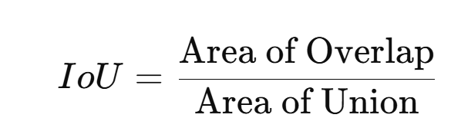
How it works
Object Detection Predictions: An object detection algorithm (like YOLO, SSD, or Faster R-CNN) predicts multiple bounding boxes for each object, each with an associated confidence score indicating how likely it is to contain the object.
Sorting by Confidence: NMS (Non-Maximum Suppression) starts by sorting all the predicted bounding boxes based on their confidence scores in descending order.
Selecting the Most Confident Box: The box with the highest confidence score is selected as the "best" box, and it is kept.
Removing Overlapping Boxes: Other boxes that overlap significantly with the best box (measured using Intersection over Union, or IoU) are removed if their IoU exceeds a predefined threshold (e.g., 0.5).
Repeating the Process: The process is repeated for the remaining boxes until all boxes are processed or removed.
Why Use NMS?
Redundancy Removal: It removes overlapping predictions for the same object, ensuring only one box is retained.
Efficiency: NMS helps in cleaner outputs by keeping only the most relevant bounding boxes.
IoU (Intersection over Union): IoU is a metric used to measure the overlap between two bounding boxes, calculated as the area of overlap divided by the area of union. Higher IoU indicates more overlap.

Slide 15
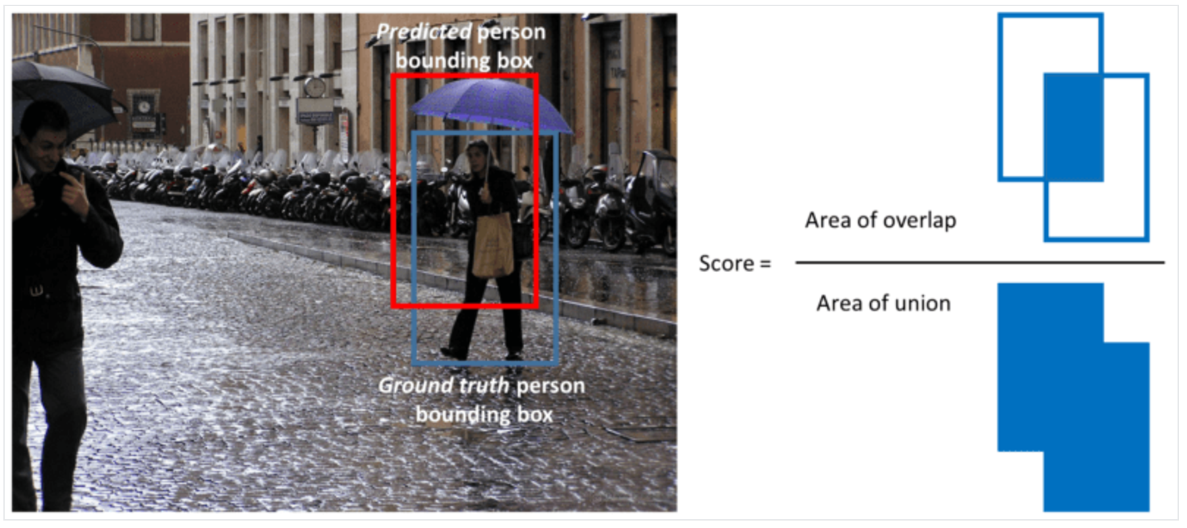
adapted

Slide 16
Evaluation metric
mean average precision mAP is a widely used evaluation metric in object detection that quantifies the performance of a model in detecting objects in images. It combines precision and recall to provide a single performance score, measuring how well the model predicts bounding boxes and identifies objects.

Slide 17
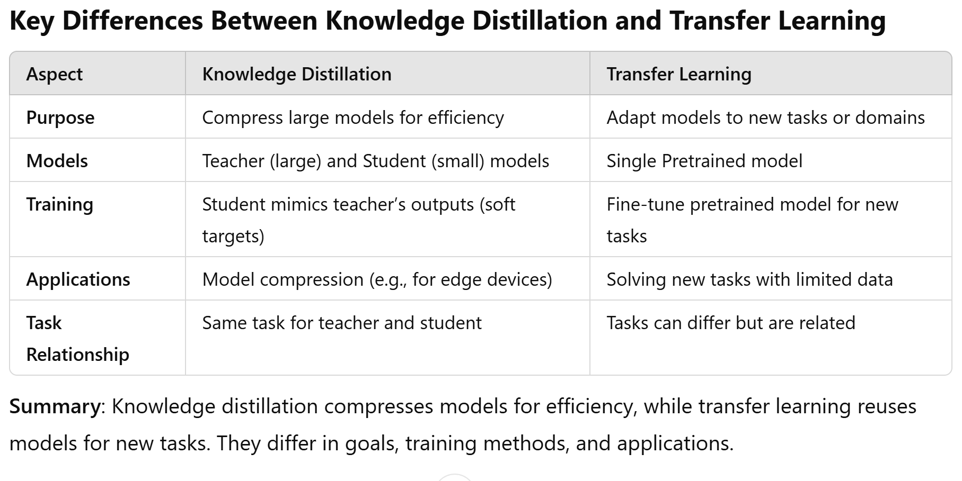

Slide 18
Knowledge Distillation
Knowledge distillation is a technique in machine learning where a smaller, simpler model (the student) is trained to mimic the behavior of a larger, more complex model (the teacher). The idea is to transfer the knowledge learned by the teacher model to the student model, enabling the student to perform similarly without the computational burden of the teacher model.
Teacher Model: A large, pre-trained model that has learned complex features from the data.
Student Model: A smaller, less complex model that tries to replicate the teacher's behavior by learning from the teacher's predictions (soft targets).
Process: Instead of training the student model with just the true labels, it is trained with the outputs (soft targets) of the teacher model, which contains more nuanced information about the data.
Benefits: Knowledge distillation helps reduce the size and computational requirements of the model while maintaining high accuracy.
Transfer Learning
Transfer learning is a technique where a model developed for one task is reused for another related task. The idea is to leverage the knowledge gained from the first task to improve the learning efficiency or performance of a model on a different task.
Pre-trained Model: The model is typically pre-trained on a large dataset (such as ImageNet) and then fine-tuned on a smaller, task-specific dataset.
Fine-Tuning: In transfer learning, you usually freeze the initial layers of the model (which capture general features like edges or textures) and retrain the later layers to adapt to the new task.
Benefits: Transfer learning speeds up the training process, reduces the need for large amounts of data, and can lead to better performance, especially when the new task has limited labeled data.
Key Differences
Goal: Knowledge distillation aims to compress knowledge from a large model into a smaller one, while transfer learning aims to reuse knowledge learned from one task to enhance learning on a related task.
Model Relationship: In knowledge distillation, the student and teacher models are typically trained for the same task, whereas in transfer learning, the pre-trained model is used for a different but related task.

